Slide 1
3
APPLICATIONS OF
DIFFERENTIATION

Slide 2
3.2
The Mean Value Theorem

Slide 3
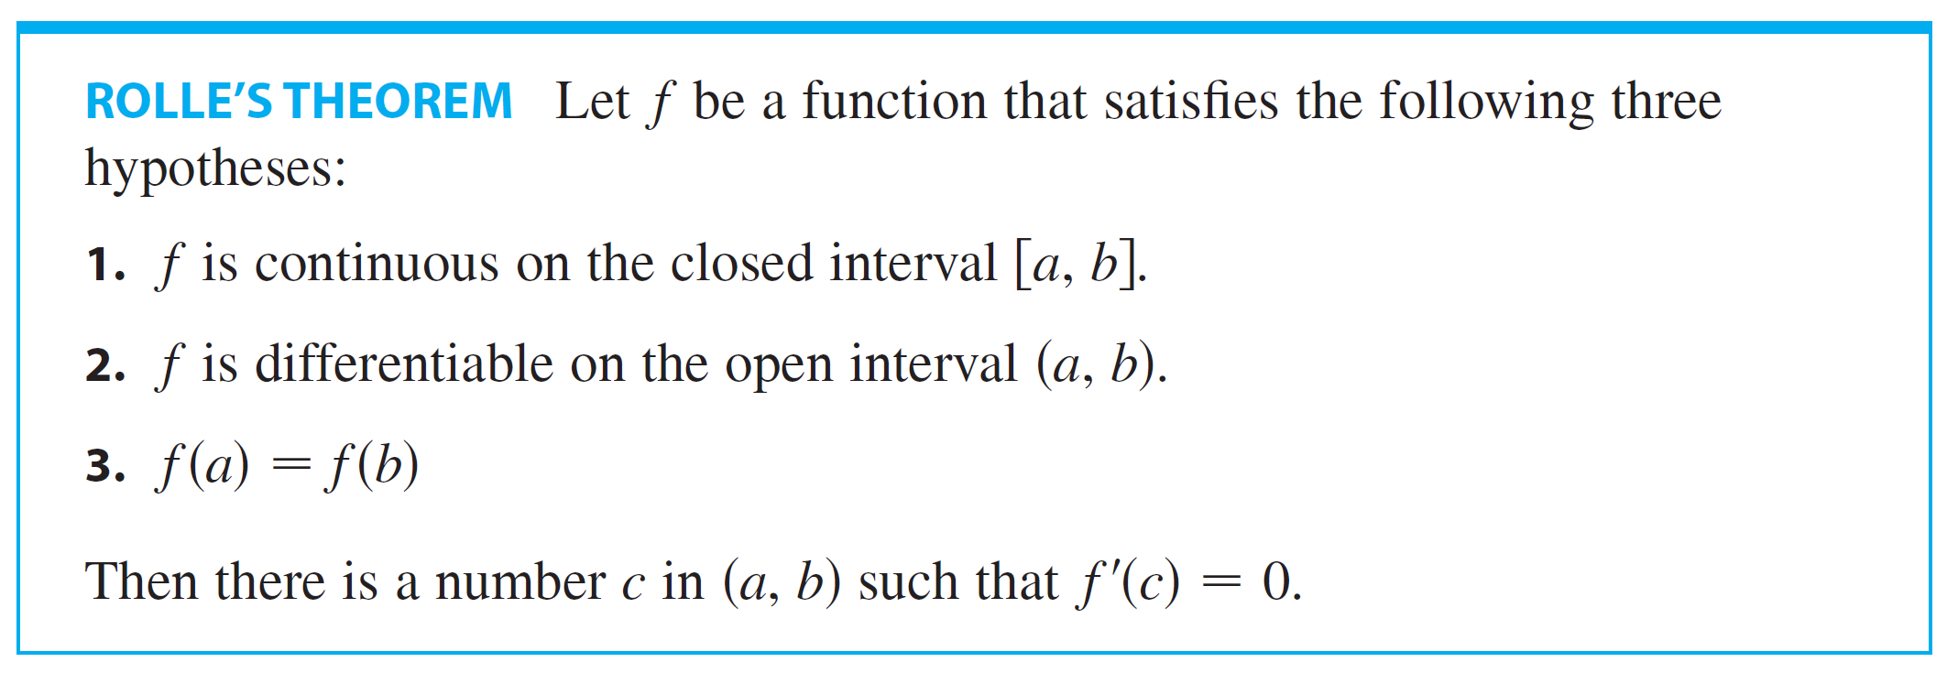
The Mean Value Theorem
Many of the results of this chapter depend on one central fact, which is called the Mean Value Theorem. But to arrive at the Mean Value Theorem we first need the following result.

Slide 4
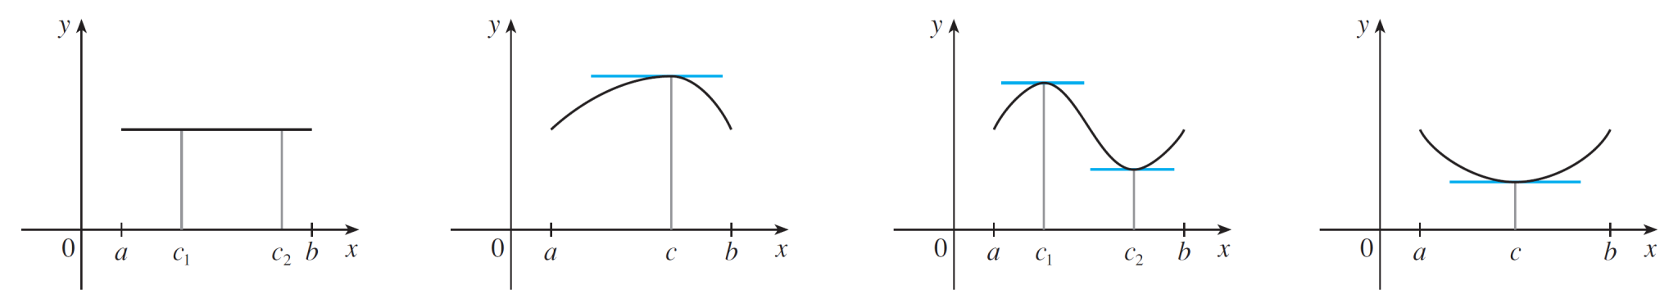
The Mean Value Theorem
Let’s take a look at the graphs of some typical functions that satisfy the three hypotheses.
Figure 1 shows the graphs of four such functions.
In each case it appears that there is at least one point (c, f (c ) ) on the graph where the tangent is horizontal and therefore f ′ (c) = 0. Thus Rolle’s Theorem is plausible.
(a)
(b)
(c)
(d)
Figure 1

Slide 5
ROLLE’S THEOREM PROOF
There are three cases:
f(x) = k, a constant
f(x) > f(a) for some x in (a, b)
f(x) < f(a) for some x in (a, b)

Slide 6
ROLLE’S THEOREM PROOF (Case I)
f(x) = k, a constant
Then, f ’(x) = 0.
So, the number c can be taken to be any number in (a, b).

Slide 7
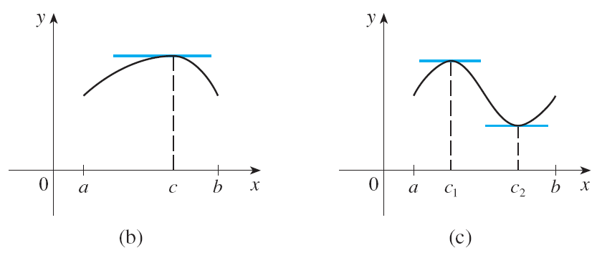
ROLLE’S THEOREM PROOF (Case II)
f(x) > f(a) for some x in (a, b)
By the Extreme Value Theorem (which we can apply by hypothesis 1), f has a maximum value somewhere in [a, b].

Slide 8
ROLLE’S THEOREM PROOF (Case II)
As f(a) = f(b), it must attain this maximum value at a number c in the open interval (a, b).
Then, f has a local maximum at c and, by hypothesis 2, f is differentiable at c.
Thus, f ’(c) = 0 by Fermat’s Theorem.

Slide 9
ROLLE’S THEOREM PROOF (Case III)
f(x) < f(a) for some x in (a, b)
By the Extreme Value Theorem, f has a minimum value in [a, b] and, since f(a) = f(b), it attains this minimum value at a number c in (a, b).
Again, f ’(c) = 0 by Fermat’s Theorem.

Slide 10
Example 1
Let’s apply the theorem to the position function s = f(t) of a moving object.
If the object is in the same place at two different instants t = a and t = b, then f(a) = f(b).
The theorem states that there is some instant of time t = c between a and b when f ’(c) = 0; that is, the velocity is 0.
In particular, you can see that this is true when a ball is thrown directly upward.

Slide 11

Example 2
Prove that the equation has exactly one real root.

Slide 12
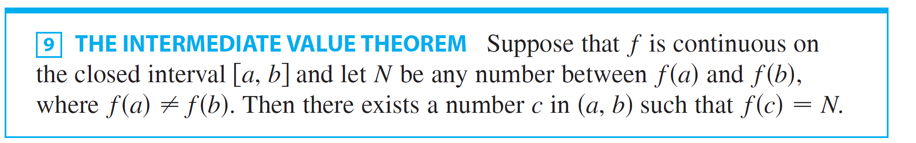
Example 2 – Solution
SOLUTION:
First we use the Intermediate Value Theorem to show that a root exists.
Let Then f (0) = -1< 0 and f (1) = 1> 0.
Since f is a polynomial, it is continuous, so the Intermediate Value Theorem states that there is a number c between 0 and 1 such that f (c)=0. Thus the given equation has a root.

Slide 13
Example 2 – Solution
cont’d
To show that the equation has no other real root, we use Rolle’s Theorem and argue by contradiction. Suppose that it had two roots a and b.
Then f (a) = 0 = f (b) and, since f is a polynomial, it is differentiable on (a, b) and continuous on [a, b].
Thus by Rolle’s Theorem there is a number c between a and b such that f ′ (c) = 0.

Slide 14

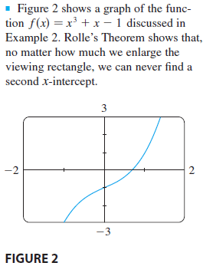
Example 2 – Solution
cont’d
But
(since x² ≥ 0) so f ′(x) can never be 0.
This gives a contradiction.
Therefore the equation can’t have
two real roots.

Slide 15
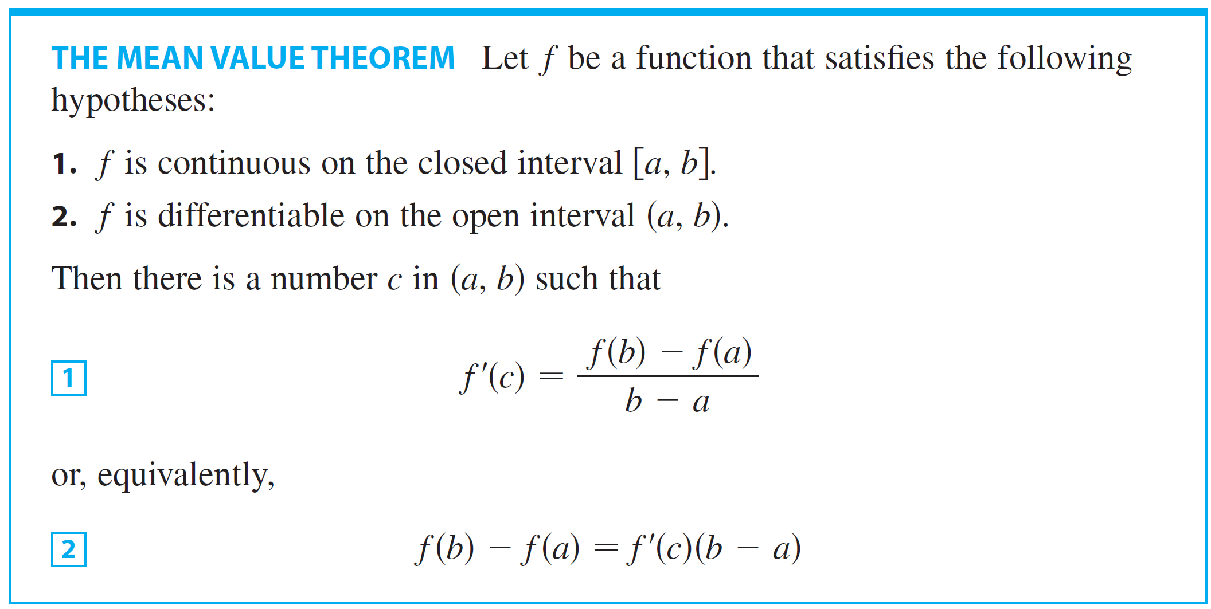
The Mean Value Theorem
Rolle’s Theorem is used in proving the following important theorem, the Mean Value Theorem.

Slide 16
THE MEAN VALUE THEOREM
Before proving this theorem, we can see that it is reasonable by interpreting it geometrically.
Figure 3 and 4 show the points A(a, f(a)) and B(b, f(b)) on the graphs of two differentiable functions.

Slide 17
THE MEAN VALUE THEOREM
The slope of the secant line AB is:
This is the same expression as on the right side of Equation 1.

Slide 18
THE MEAN VALUE THEOREM
f ’(c) is the slope of the tangent line at (c, f(c)).
So, the Mean Value Theorem—in the form given by Equation 1—states that there is at least one point P(c, f(c)) on the graph where the slope of the tangent line is the same as the slope of the secant line AB.
In other words, there is a point P where the tangent line is parallel to the secant line AB.

Slide 19
THE MEAN VALUE THEOREM PROOF
We apply Rolle’s Theorem to a new function h defined as the difference between f and the function whose graph is the secant line AB.
Using Equation 3, we see that the equation of the line AB can be written as: or as:

Slide 20
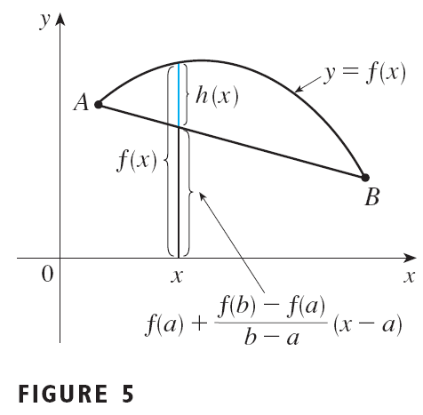
THE MEAN VALUE THEOREM PROOF
So, as shown in Figure 5,
First, we must verify that h satisfies the three hypotheses of Rolle’s Theorem—as follows.

Slide 21
THE MEAN VALUE THEOREM PROOF -HYPOTHESIS 1
The function h is continuous on [a, b] because it is the sum of f and a first-degree polynomial, both of which are continuous.

Slide 22
THE MEAN VALUE THEOREM PROOF -HYPOTHESIS 2
The function h is differentiable on (a, b) because both f and the first-degree polynomial are differentiable.
In fact, we can compute h’ directly from Equation 4:
Note that f(a) and [f(b) – f(a)]/(b – a) are constants.

Slide 23
THE MEAN VALUE THEOREM PROOF -HYPOTHESIS 3
Therefore, h(a) = h(b).

Slide 24
THE MEAN VALUE THEOREM PROOF
As h satisfies the hypotheses of Rolle’s Theorem, that theorem states there is a number c in (a, b) such that h’(c) = 0.
Therefore,
So,

Slide 25

Example 3
To illustrate the Mean Value Theorem with a specific function, let’s consider .
Since f is a polynomial, it is continuous and differentiable for all x, so it is certainly continuous on [0, 2] and differentiable on (0, 2).
Therefore, by the Mean Value Theorem, there is a number c in (0, 2) such that

Slide 26






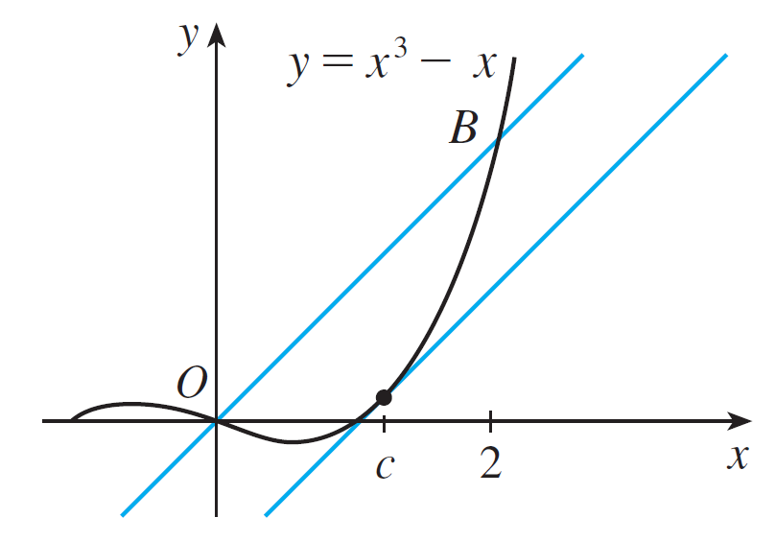
Example 3
cont’d
Now , and , so this equation becomes
which gives , that is, .
But c must lie in (0, 2), so .
Figure 6 illustrates this calculation: The tangent line at this value of c is parallel to the secant line OB.
Figure 6

Slide 27
Example 4
If an object moves in a straight line with position function s = f(t), then the average velocity between t = a and t = b is and the velocity at t = c is f ’(c).

Slide 28
Example 4
Thus, the Mean Value Theorem—in the form of Equation 1—tells us that, at some time t = c between a and b, the instantaneous velocity f ’(c) is equal to that average velocity.
For instance, if a car traveled 180 km in 2 hours, the speedometer must have read 90 km/h at least once.
In general, the Mean Value Theorem can be interpreted as saying that there is a number at which the instantaneous rate of change is equal to the average rate of change over an interval.

Slide 29
The Mean Value Theorem
The main significance of the Mean Value Theorem is that it enables us to obtain information about a function from information about its derivative.
The next example provides an instance of this principle.

Slide 30
Example 5
Suppose that f (0) = –3 and f ′(x ) ≤ 5 for all values of x. How large can f (2) possibly be?

Slide 31

Example 5 – Solution
SOLUTION:
We are given that f is differentiable (and therefore continuous) everywhere.
In particular, we can apply the Mean Value Theorem on the interval [0, 2].
There exists a number c such that

Slide 32
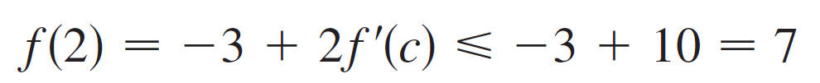
Example 5 – Solution
cont’d
so
We are given that f ′(x) ≤ 5 for all x, so in particular we know that f ′(c) ≤ 5 .
Multiplying both sides of this inequality by 2, we have 2f ′(c) ≤ 10 , so
The largest possible value for f(2) is 7.

Slide 33
THE MEAN VALUE THEOREM
The Mean Value Theorem can be used to establish some of the basic facts of differential calculus.
One of these basic facts is the following theorem.
Others will be found in the following sections.

Slide 34
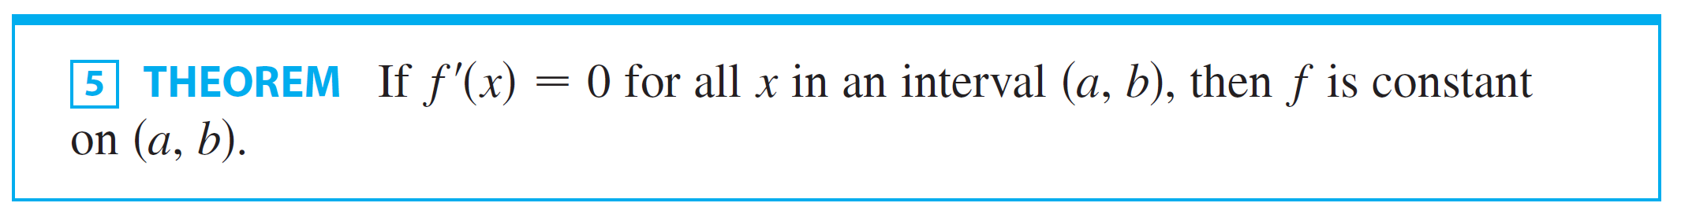
The Mean Value Theorem
The Mean Value Theorem can be used to establish some of the basic facts of differential calculus.
One of these basic facts is the following theorem.

Slide 35
Theorem 5
PROOF
Let x₁ and x₂ be any two numbers in (a, b) with x₁ < x₂.
Since f is differentiable on (a, b), it must be differentiable on (x₁, x₂) and continuous on [x₁, x₂].

Slide 36
Theorem 5
By applying the Mean Value Theorem to f on the interval [x₁, x₂], we get a number c such that x₁ < c < x₂ and f(x₂) – f(x₁) = f ’(c)(x₂ – x₁)
Since f ’(x) = 0 for all x, we have f ’(c) = 0.
So, Equation 6 becomes f(x₂) – f(x₁) = 0 or f(x₂) = f(x₁)
Therefore, f has the same value at any two numbers x₁ and x₂ in (a, b).
This means that f is constant on (a, b).

Slide 37
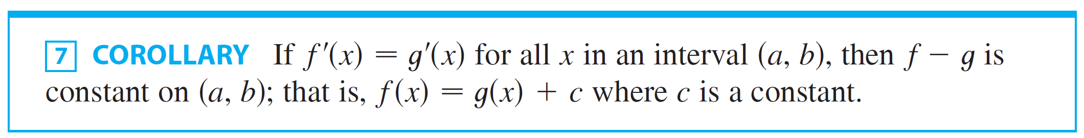
Corollary 7
PROOF
Let F(x) = f(x) – g(x).
Then, F’(x) = f ’(x) – g ’(x) = 0 for all x in (a, b).
Thus, by Theorem 5, F is constant.
That is, f – g is constant.

Slide 38
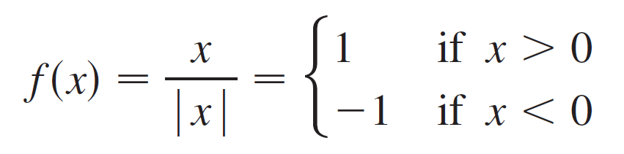


The Mean Value Theorem
Care must be taken in applying Theorem 5. Let
The domain of f is and f ′(x) = 0 for all x in D.
But f is obviously not a constant function. This does not contradict Theorem 5 because D is not an interval.
Notice that f is constant on the interval (0, ) and also on the interval
( , 0).

